Slide 1
IT Ticket Analysis Presentation By: Amanjeet Saroha

Slide 2
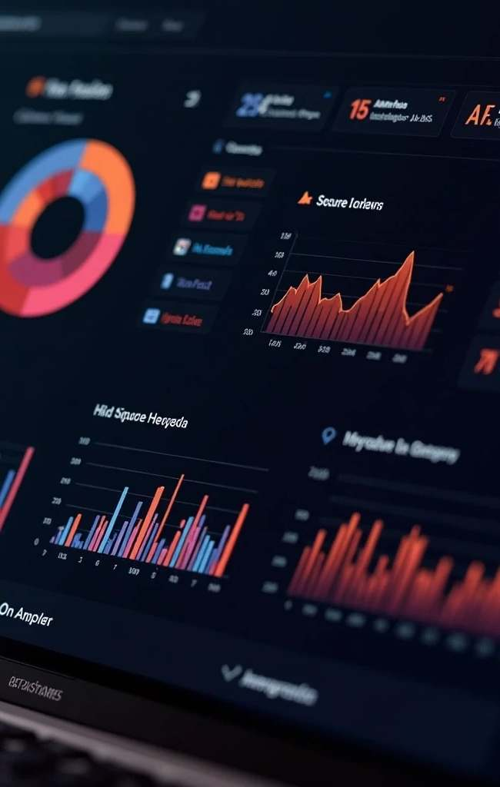
Problem Statement
Rapid increase in IT support tickets year-over-year
Growing complexity of technical issues faced by employees
Existing resolution processes resulting in inconsistent user satisfaction
Management lacks clear visibility into IT support performance
Need to optimize IT operations, improve resolution efficiency, and enhance user satisfaction

Slide 3
Data Overview
TOTAL TICKETS RESOLVED
ANALYSIS TIME FRAME
KEY TICKET ATTRIBUTES
AGENT PERFORMANCE METRICS
DATA QUALITY ASSURANCE
A substantial total of 97,499 tickets were resolved by 50 IT Agents over 5 Years of time (2016-2020).
The dataset covers a significant time span from 2016 to 2020, enabling historical performance analysis.
The tickets include 10 essential attributes such as Satisfaction Rate and Resolution Time for detailed insights.
The dataset includes 6 specific agent data attributes for a thorough performance evaluation.
High data quality is ensured with no blank values and standardized formats, facilitating effective analysis.

Slide 4
Result Analysis
The agenda focuses on a detailed analysis of 97,499 cases resolved by 50 agents from 2016 to 2020, providing insights to guide future investments in IT service desk operations. It includes a comprehensive evaluation of ticket categories, satisfaction rates, and resolution times, along with a comparative study of key performance metrics. An interactive dashboard will be showcased to monitor agent performance and overall progress, accompanied by actionable recommendations to optimize IT service desk efficiency and improve operational outcomes.

Slide 5
Trend Analysis
Insights:
The volume of IT support tickets has more than doubled from 13,051 in 2016 to 29,088 in 2020.
There is a consistent year-on-year upward trend, indicating increasing demand for IT support services.
Recommendation:-
Review and upgrade IT support infrastructure to handle the rising ticket volume efficiently.
Consider proactive measures like automation and self-service portals to reduce the ticket burden on support staff.

Slide 6
Categorical Data Overview
Severity Insights-
Most tickets (88,656) are marked Normal, but Urgent (1,392) and Major (4,836) cases point to critical issues needing swift action.
Recommendation
Tighten severity classification rules
Prioritize Urgent and Major tickets with faster resolution strategies

Slide 7
Request Category
Insights:-
System (39,002) and Login Access (29,193) requests account for the largest share of overall tickets.
Hardware requests (9,733) form the smallest category but often involve complex resolution, as seen in other analyses.
Recommendation:-
Prioritize process optimization for System and Login Access categories to manage high demand efficiently.
Review resolution workflows and resource allocation for Hardware to minimize delays despite its lower volume.

Slide 8
Priority
Insights:-
A significant number of tickets (29,410) have Unassigned Priority, indicating potential process gaps.
High Priority tickets account for 35,549, representing critical workload that requires urgent attention.
Recommendation:-
Implement mandatory priority assignment during ticket creation to avoid delays.
Allocate dedicated resources or fast-track workflows for High Priority tickets to ensure timely resolution.

Slide 9
Satisfaction Rate vs Years
Insights:-
User satisfaction has steadily improved from 3.98 in 2016 to 4.16 in 2020.
The consistent upward trend reflects positive impact of existing process improvements.
Recommendation:-
Continue enhancing support processes to sustain this positive momentum.
Focus efforts on categories with lower satisfaction to accelerate overall improvement.

Slide 10
Resolution Time vs Years
Insights:-
Resolution time has remained relatively stable, averaging between 4.52 and 4.59 days.
A slight increase is observed in 2020, suggesting potential process bottlenecks as ticket volume grows.
Recommendation:-
Review processes and resource allocation to address the 2020 increase.
Explore automation or self-service options to reduce resolution times as demand rises.

Slide 11
Age Group vs Satisfaction & Resolution Time
Insights:-
Agents aged 33–37 have the longest resolution time (5.01 days) and the lowest satisfaction rate (3.96).
Younger agents aged 28–32 deliver better performance with faster resolution (4.43 days) and higher satisfaction (4.21).
Recommendation:-
Provide targeted training and performance support for the 33–37 age group to improve efficiency.
Encourage knowledge sharing from higher-performing age groups to uplift overall team performance.

Slide 12
Distribution by Satisfaction Rate
Insights:-
A large proportion of tickets (50,770) received the highest satisfaction rating (5), indicating strong service quality.
However, nearly 12,000 tickets have low satisfaction scores (1 or 2), highlighting areas for improvement.
Recommendation:-
A large proportion of tickets (50,770) received the highest satisfaction rating (5), indicating strong service quality.
However, nearly 12,000 tickets have low satisfaction scores (1 or 2), highlighting areas for improvement.

Slide 13
Distribution by Resolution Days
Insights:-
Majority of tickets (25,071) are resolved on the same day, reflecting good responsiveness for many issues.
A significant number of tickets take 5 to 8 days, indicating delays for more complex or resource-dependent cases.
Recommendations:-
Investigate the nature of tickets with extended resolution times and streamline processes where possible.
Expand knowledge bases and automation for common issues to reduce reliance on manual intervention and speed up resolutions.

Slide 14
Category-wise Satisfaction Score and Resolution time
Insights-
Hardware and System requests take longest to resolve but still show moderate satisfaction (~4.10).
Login Access is fastest (0.31 days) but has slightly lower satisfaction (4.09).
Recommendation:-
Enhance Hardware/System processes to cut delays
Review Login Access flow to boost user experience.

Slide 15
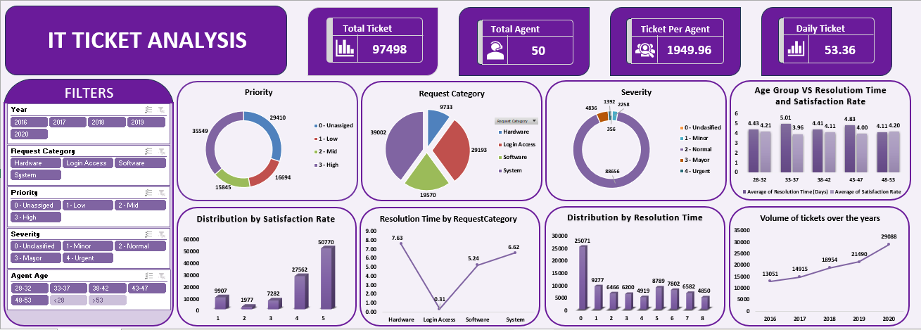
Dashboard Visualization Overview

Slide 16
Filters used
The dashboard is designed to allow dynamic analysis using these filters:
Year: Filter across 2016 to 2020 to observe trends over time.
Severity: Classifies tickets into Unclassified, Minor, Normal, Major, and Urgent.
Request Category: Filter Across Hardware, Software, Login Access, System
Priority: Ranges from Unassigned to High.
Agent Age: Grouped in 5-year intervals from 28‒32 up to 48‒53.
These filters empower the viewer to slice the data by time period, issue criticality, workload distribution, and team demographics.

Slide 17
Dash Board Insights
VOLUME AND TEAM CAPACITY
PRIORITY &
SEVERITY
BALANCE
REQUEST DISTRIBUTION
PERFORMANCE OVER TIME
AGENT AGE VS
PERFORMANCE
Satisfaction Rate and Resolution Time over years help correlate service quality with process efficiency
Trends from 2016 ‒2020 show how support has evolved -useful for assessing the impact of policy or tool changes.
Total Tickets: 97,498 handled
Total Agents: 50
Ticket per agent:
~1,950 suggest high efficiency or potential agent overload
Daily Tickets: 53.36 steady demand
High-priority issues dominate, which can pressure resolution teams.
Most tickets are of Normal severity, but the small volume of Major and Urgent cases still demand specialized attention.
Software-related tickets are the most frequent, pointing to where most end- user issues arise.
Login access is the second-highest-likely candidates for automation to ease workload.
A chart contrasts agent age groups with resolution times and satisfaction rates, offering insights into training needs or experience advantages

Slide 18
Final Recommendation
Upgrade Ticket Management Software: To address priority-severity misalignment and ensure accurate, automated ticket classification.
Invest in Automation and Self-Service: Particularly for common issues like Login Access to reduce manual workload and resolution times.
Targeted Training for Underperforming Agents: Focus on agents aged 33–37 and those with low satisfaction scores and longer resolution times.
Prioritize Process Improvement for Hardware & System Requests: These categories face the longest delays and require better tools, diagnostics, and workflows.
Proactive Resource Planning: Rising ticket volumes demand optimized staffing and efficient workload distribution to avoid future bottlenecks.
Continuous Monitoring via Interactive Dashboard: Use the final dashboard regularly to track performance, identify gaps, and guide strategic IT support decisions.

Slide 19
Summarized Conclusion
IT ticket analysis reveals both strengths and critical improvement areas
Process optimization and software upgrades are essential
Training underperforming agents will drive efficiency gains
Data-driven dashboard provides actionable insights for continuous improvement
With the right interventions, IT support performance and user satisfaction can be significantly enhanced

Slide 20
Thank You

